Slide 1
Unit - IV
Java . Util package
and
JDBC

Slide 2
Collections Overview
The Collection in Java is a framework that provides an architecture to store and manipulate the group of objects.
Java Collections can achieve all the operations that you perform on a data such as searching, sorting, insertion, manipulation, and deletion.
Java Collection means a single unit of objects. Java Collection framework provides many interfaces
The java.util package contains all the classes and interfaces for the Collection framework.

Slide 3
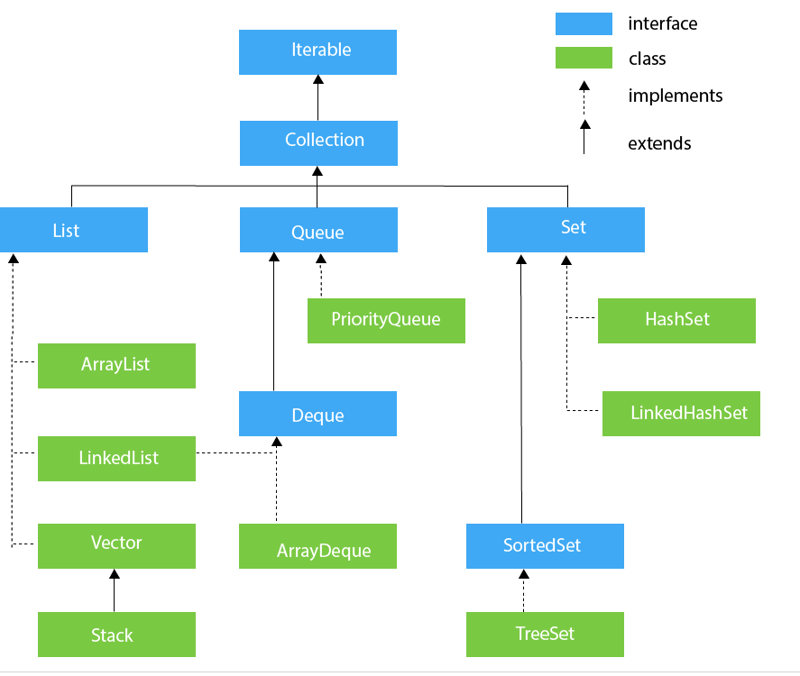
Hierarchy of Collection Framework

Slide 4
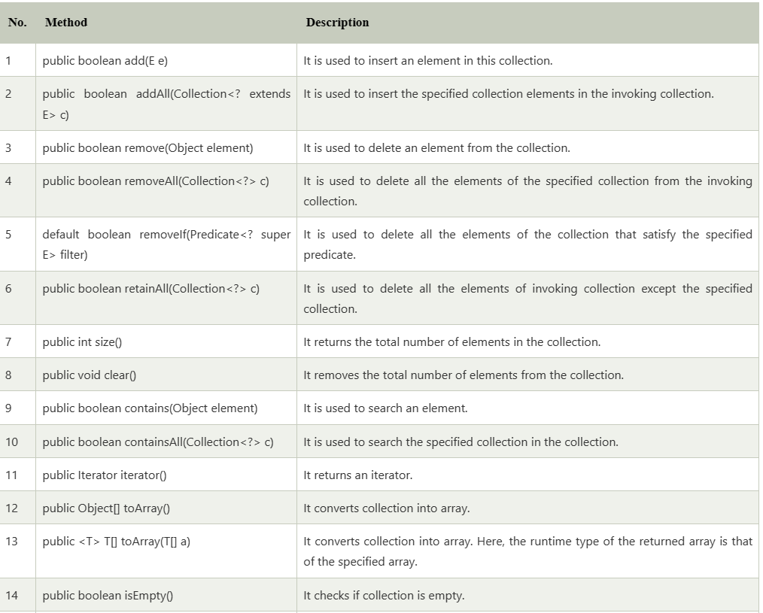

Slide 5
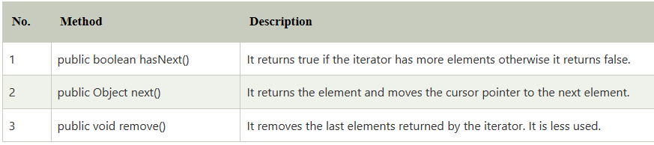
Iterator interface
Iterator interface provides the facility of iterating the elements in a forward direction only.

Slide 6
List Interface
List interface is the child interface of Collection interface. It inhibits a list type data structure in which we can store the ordered collection of objects. It can have duplicate values.
List interface is implemented by the classes ArrayList, LinkedList, Vector, and Stack.
List <data-type> list1= new ArrayList();
List <data-type> list2 = new LinkedList();
List <data-type> list3 = new Vector();
List <data-type> list4 = new Stack();

Slide 7
import java.util.*;
class TestJavaCollection1{
public static void main(String args[]){
ArrayList<String> list=new ArrayList<String>();//Creating arraylist
list.add("Ravi");//Adding object in arraylist
list.add("Vijay");
list.add("Ravi");
list.add("Ajay");
//Traversing list through Iterator
Iterator itr=list.iterator();
while(itr.hasNext()){
System.out.println(itr.next());
}
}
}

Slide 8
Add elements
Access elements
Change elements
Remove elements
Write a Java program to insert an element into the array list at the first position

Slide 9
import java.util.ArrayList; class Main { public static void main(String[] args) { ArrayList<String> animals = new ArrayList<>();
// add elements in the arraylist
animals.add("Cat");
animals.add("Dog");
animals.add("Cow");
System.out.println("ArrayList: " + animals);
// get the element from the arraylist
String str = animals.get(1);
System.out.print("Element at index 1: " + str);
} }

Slide 10
LinkedList
LinkedList implements the Collection interface. It uses a doubly linked list internally to store the elements.
It can store the duplicate elements.
It maintains the insertion order and is not synchronized.
In LinkedList, the manipulation is fast because no shifting is required.
import java.util.*;
public class TestJavaCollection2{
public static void main(String args[]){
LinkedList<String> al=new LinkedList<String>();
al.add("Ravi");
al.add("Vijay");
al.add("Ravi");
al.add("Ajay");
Iterator<String> itr=al.iterator();
while(itr.hasNext()){
System.out.println(itr.next());
}
}
}

Slide 11
Vector
Vector uses a dynamic array to store the data elements.
It is similar to ArrayList.
However, It is synchronized and contains many methods that are not the part of Collection framework.
import java.util.*;
public class TestJavaCollection3{
public static void main(String args[]){
Vector<String> v=new Vector<String>();
v.add("Ayush");
v.add("Amit");
v.add("Ashish");
v.add("Garima");
Iterator<String> itr=v.iterator();
while(itr.hasNext()){
System.out.println(itr.next());
}
}
}

Slide 12
Stack
The stack is the subclass of Vector. It implements the last-in-first-out data structure, i.e., Stack.
The stack contains all of the methods of Vector class and also provides its methods like boolean push(), boolean peek(), boolean push(object o), which defines its properties.
import java.util.*;
public class TestJavaCollection4{
public static void main(String args[]){
Stack<String> stack = new Stack<String>();
stack.push("Ayush");
stack.push("Garvit");
stack.push("Amit");
stack.push("Ashish");
stack.push("Garima");
stack.pop();
Iterator<String> itr=stack.iterator();
while(itr.hasNext()){
System.out.println(itr.next());
}
}
}

Slide 13
Queue Interface
Queue interface maintains the first-in-first-out order.
It can be defined as an ordered list that is used to hold the elements which are about to be processed.
There are various classes like PriorityQueue, Deque, and ArrayDeque which implements the Queue interface.
we did not tell the priority queue how to prioritize its content, it used a default natural ordering. In this case, it gave us the data back in the ascending order of the strings. This is not the same order in which items were added to the queue.
Queue<String> q1 = new PriorityQueue();
Queue<String> q2 = new ArrayDeque();

Slide 14
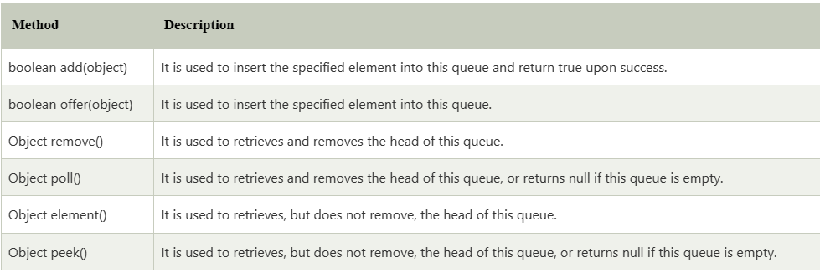

Slide 15
import java.util.*;
public class TestJavaCollection5{
public static void main(String args[]){
PriorityQueue<String> queue=new PriorityQueue<String>();
queue.add(“H");
queue.add(“A");
queue.add(“D");
queue.add(“C");
System.out.println("head:"+queue.element());
System.out.println("head:"+queue.peek()); //latest item in the queue without removing it
System.out.println("iterating the queue elements:");
Iterator itr=queue.iterator();
while(itr.hasNext()){
System.out.println(itr.next());
}
queue.remove();
queue.poll(); //will give us the latest item and also remove it from the queue
System.out.println("after removing two elements:");
Iterator<String> itr2=queue.iterator();
while(itr2.hasNext()){
System.out.println(itr2.next());
}
}
}
head:A
head:A
iteratin the queue elements:
A
C
D
H
after removing two elements:
D
H

Slide 16
Priority queue with customizing order
Use of comparator: In order to create a comparator, we implement the comparator interface and override the compare method.
static class CustomIntegerComparator implements Comparator<Integer>
{
@Override
public int compare(Integer o1, Integer o2)
{ return o1 < o2 ? 1 : -1;
}
}
By using o1 < o2 ? 1 : -1 we will get the result in descending order.
If we had used o1 > o2 ? 1 : -1, then we would have gotten the result in ascending order

Slide 17
Queue<Integer> testIntegersPQ = new PriorityQueue<>(new CustomIntegerComparator());
testIntegersPQ.add(11); testIntegersPQ.add(5); testIntegersPQ.add(-1); testIntegersPQ.add(12); testIntegersPQ.add(6);
System.out.println("Integers stored in reverse order of priority in a Priority Queue\n");
while (!testIntegersPQ.isEmpty())
{ System.out.println(testIntegersPQ.poll());
}
12 11 6 5 -1

Slide 18
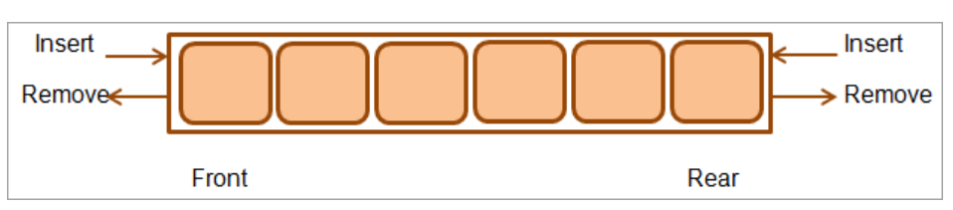
Deque<String> numdeque = new ArrayDeque<> (); Deque<String> strDeque = new LinkedList<> ();
Deque<String> numdeque = new ArrayDeque<> (); Deque<String> strDeque = new LinkedList<> ();
Deque Interface
Deque interface extends the Queue interface.
In Deque, we can remove and add the elements from both the side.
Deque stands for a double-ended queue which enables us to perform the operations at both the ends.
Deque d = new ArrayDeque();
Deque d = new LinkedList();

Slide 19
import java.util.*;
public class TestJavaCollection6{
public static void main(String[] args) {
//Creating Deque and adding elements
Deque<String> deque = new ArrayDeque<String>();
deque.add("Gautam");
deque.add("Karan");
deque.add("Ajay");
//Traversing elements
for (String str : deque) {
System.out.println(str);
}
}
}

Slide 20
// Iterate using Reverse order iterator
Iterator reverse = deque.descendingIterator();
System.out.println("\n\nDeque contents using Reverse Iterator:");
while (reverse.hasNext())
System.out.print(" " + reverse.next());
// Peek () method
System.out.println("\n\nDeque Peek:" + deque.peek());
System.out.println("\nDeque,After peek:" + deque);
// Pop () method
System.out.println("\nDeque Pop:" + deque.pop());
System.out.println("\nDeque,After pop:" + deque);
// contains () method
System.out.println("\nDeque Contains Three: " + deque.contains("Three"));
deque.removeFirst(); //removeFirst ()
deque.removeLast(); //removeLast ()
System.out.println("\nDeque, after removing " + "first and last elements: " + deque);
}
}
import java.util.*;
public class Main {
public static void main(String[] args) {
//Declare Deque object
Deque<String> deque = new LinkedList<String>();
// add elements to the queue using various methods
deque.add("One"); //add ()
deque.addFirst("Two"); //addFirst ()
deque.addLast("Three"); //addLast ()
deque.push("Four"); //push () add at the first
deque.offer("Five"); //offer () add at the last
deque.offerFirst("Six"); //offerFirst ()
deque.offerLast("Seven"); //offerLast ()
System.out.println("Initial Deque:");
System.out.print(deque + " ");
// Iterate using standard iterator
System.out.println("\n\nDeque contents using Standard Iterator:");
Iterator iterator = deque.iterator();
while (iterator.hasNext())
System.out.print(" " + iterator.next());

Slide 21
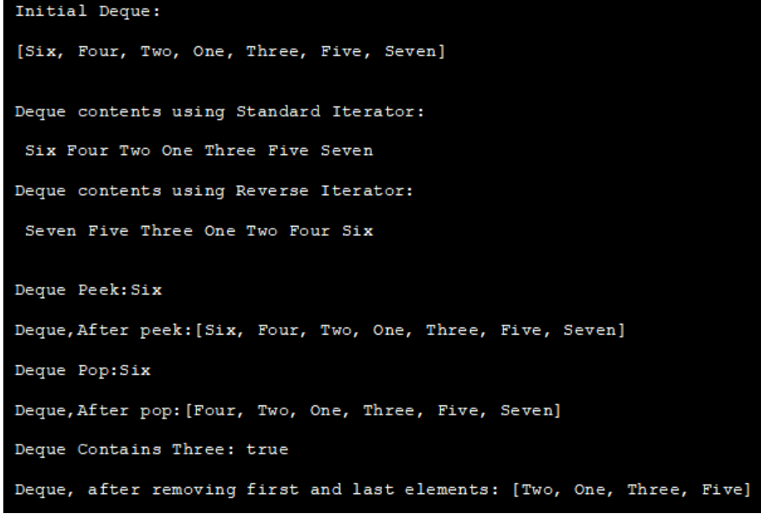

Slide 22
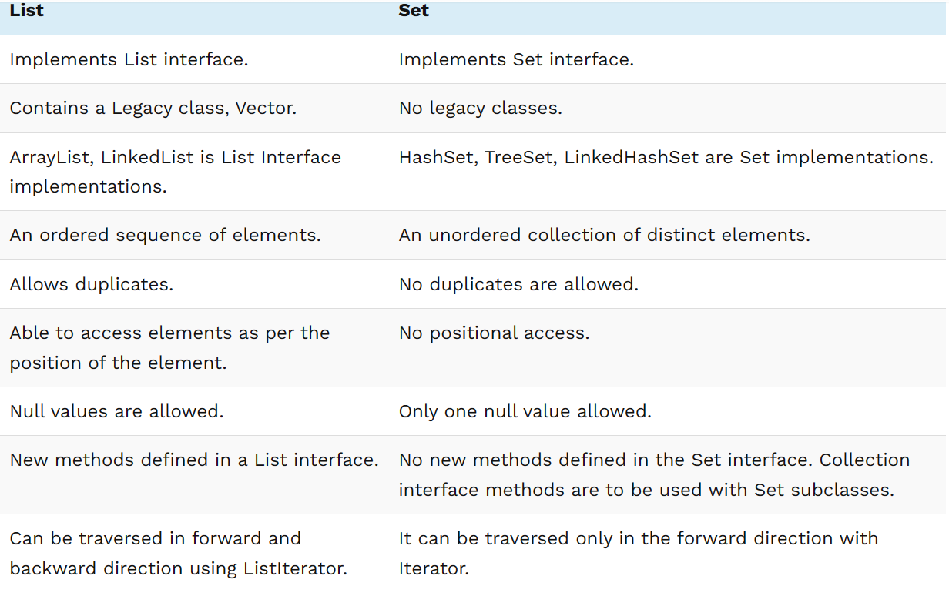
Differences between lists and sets

Slide 23
Set Interface
Set Interface in Java is present in java.util package.
It extends the Collection interface.
It represents the unordered set of elements which doesn't allow us to store the duplicate items. We can store at most one null value in Set. Set is implemented by HashSet, LinkedHashSet, and TreeSet.
Set<data-type> s1 = new HashSet<data-type>();
Set<data-type> s2 = new LinkedHashSet<data-type>();
Set<data-type> s3 = new TreeSet<data-type>();
Operations:
Insertion : retainAll()
Union : addAll()
Difference : removeAll()
Subset: containsAll()

Slide 24
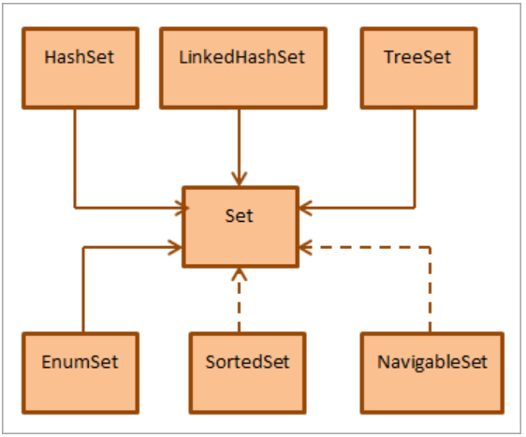

Slide 25
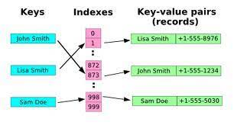
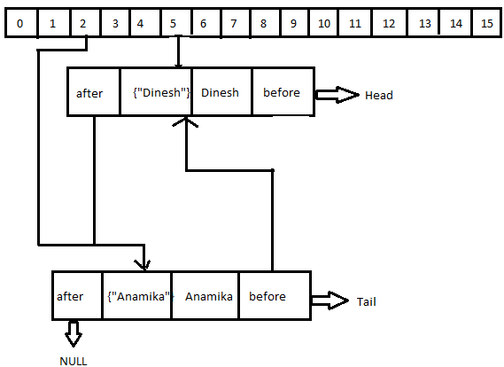
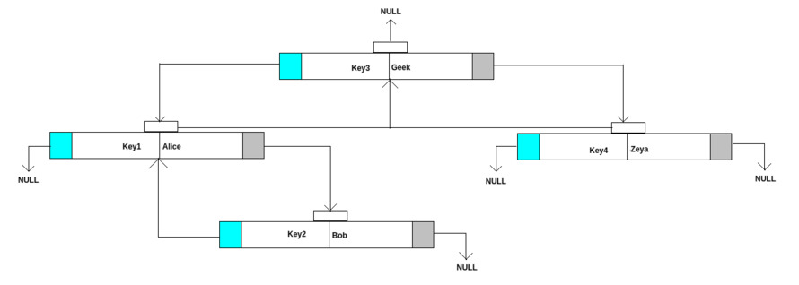
Hashmap
LinkedHashmap
Treemap

Slide 26
Hash maps are a common data structure used to store key-value pairs for efficient retrieval.
A value stored in a hash map is retrieved using the key under which it was stored
HashSet is an unordered & unsorted collection of the data set,
whereas the LinkedHashSet is an ordered and sorted collection of HashSet.
HashSet does not provide any method to maintain the insertion order.
HashSet uses HashMap internally to store it's elements.
LinkedHashSet uses LinkedHashMap internally to store it's elements.
TreeSet uses TreeMap internally to store it's elements.
Java TreeMap class is a red-black tree based implementation

Slide 27
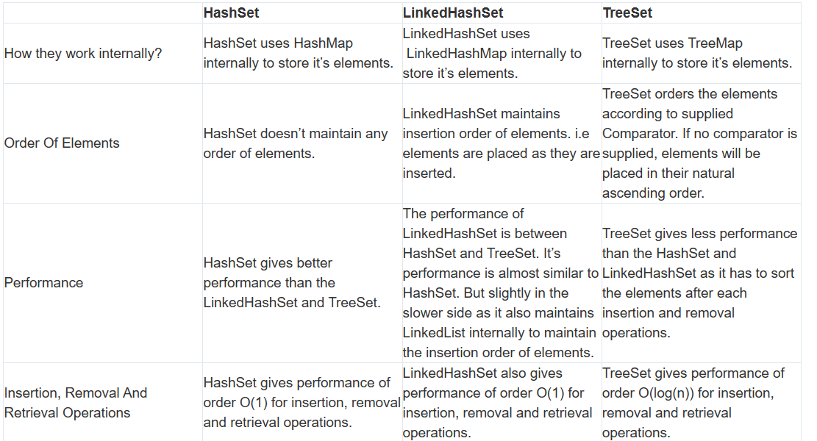

Slide 28
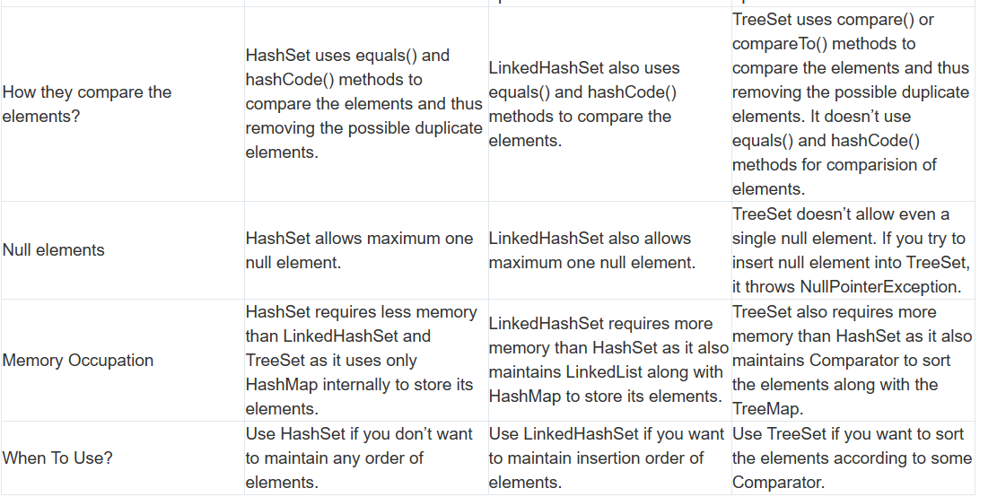

Slide 29
Similarities Between HashSet, LinkedHashSet and TreeSet In Java :
All three doesn’t allow duplicate elements.
All three are not synchronized.
All three are Cloneable and Serializable.
Iterator returned by all three is fail-fast in nature. i.e You will get ConcurrentModificationException if they are modified after the creation of Iterator object.

Slide 30
add() - adds the specified element to the set
addAll() - adds all the elements of the specified collection to the set
iterator() - returns an iterator that can be used to access elements of the set sequentially
remove() - removes the specified element from the set
removeAll() - removes all the elements from the set that is present in another specified set
retainAll() - retains all the elements in the set that are also present in another specified set
clear() - removes all the elements from the set
size() - returns the length (number of elements) of the set
toArray() - returns an array containing all the elements of the set
contains() - returns true if the set contains the specified element
containsAll() - returns true if the set contains all the elements of the specified collection
hashCode() - returns a hash code value (address of the element in the set)

Slide 31
import java.util.*;
public class TestJavaCollection7{
public static void main(String args[]){
//Creating HashSet and adding elements
HashSet<String> set=new HashSet<String>();
set.add("Ravi");
set.add("Vijay");
set.add("Ravi");
set.add("Ajay");
//Traversing elements
Iterator<String> itr=set.iterator();
while(itr.hasNext()){
System.out.println(itr.next());
}
}
}

Slide 32
import java.util.*;
public class SetOperations
{
public static void main(String args[])
{
Integer[] A = {22, 45,33, 66, 55, 34, 77};
Integer[] B = {33, 2, 83, 45, 3, 12, 55};
Set<Integer> set1 = new HashSet<Integer>();
set1.addAll(Arrays.asList(A));
Set<Integer> set2 = new HashSet<Integer>();
set2.addAll(Arrays.asList(B));
// Finding Union of set1 and set2
Set<Integer> union_data = new HashSet<Integer>(set1);
union_data.addAll(set2);
System.out.print("Union of set1 and set2 is:");
System.out.println(union_data);
// Finding Intersection of set1 and set2
Set<Integer> intersection_data = new HashSet<Integer>(set1);
intersection_data.retainAll(set2);
System.out.print("Intersection of set1 and set2 is:");
System.out.println(intersection_data);
// Finding Difference of set1 and set2
Set<Integer> difference_data = new HashSet<Integer>(set1);
difference_data.removeAll(set2);
System.out.print("Difference of set1 and set2 is:");
System.out.println(difference_data);
}
}

Slide 33
import java.io.*;
import java.util.*;
class addAllMethod {
public static void main(String args[])
{
Set<Integer> data = new LinkedHashSet<Integer>();
data.add(31);
data.add(21);
data.add(41);
System.out.println("Set: " + data);
ArrayList<Integer> newData = new ArrayList<Integer>();
newData.add(91);
newData.add(71);
newData.add(81);
data.addAll(newData);
System.out.println("Set: " + data);
}
}

Slide 34
The Java program below converts the Set to an Array.
import java.util.*; public class Main { public static void main(String[] args) { //declare a set class (HashSet) Set<String> setOfColors= new HashSet<>(); // add data to HashSet setOfColors.add("Red"); setOfColors.add("Green"); setOfColors.add("Blue"); setOfColors.add("Cyan"); setOfColors.add("Magenta"); //print the set System.out.println("The set contents:" + setOfColors); //convert Set to Array using toArray () method String colors_Array[] = setOfColors.toArray(new String[setOfColors.size()]); //print the Array System.out.println("Set converted to Array:" + Arrays.toString(colors_Array)); } }

Slide 35
Java program convert an array to set.
import java.util.*; public class Main { public static void main(String[] args) { //declare an array Integer[] numArray = {10,50,40,20,60,30,80,70}; System.out.println("The input array:" + Arrays.toString(numArray)); //Approach 1: create a set class and provide array //converted to list as constructor arg Set<Integer> numSet = new HashSet<>(Arrays.asList(numArray)); //print the set System.out.println("\nArray converted to set through asList:" + numSet); //create another set Set<Integer> intSet = new HashSet<>(); //Approach 2: use Collections.addAll method to copy array elements to the set Collections.addAll(intSet, numArray); //print the set System.out.println("\nArray converted to set using Collections.addAll:" + intSet); } }

Slide 36
The Java program below converts the set to an ArrayList.
import java.util.*; public class Main { public static void main(String[] args) { //declare a set class and initialize it Set<String> strSet= new HashSet<>(); strSet.add("one"); strSet.add("two"); strSet.add("three"); strSet.add("four"); strSet.add("five"); //print the set System.out.println("The set contents: " + strSet); //declare an ArrayList List<String> strList = new ArrayList<>(); //using addAll method,copy set elements to ArrayList strList.addAll(strSet); //print the ArrayList System.out.println("The ArrayList from set : " + strList); } }

Slide 37
The following Java program implements this conversion.
import java.util.*; public class Main { public static void main(String[] args) { //declare an ArrayList and initialize it List<String> strList = new ArrayList<>(); strList.add("one"); strList.add("two"); strList.add("three"); strList.add("four"); strList.add("five"); //print the ArrayList System.out.println("The ArrayList: " + strList); //declare a set class with ArrayList as argument to the constructor Set<String> strSet= new HashSet<>(strList); //print the set System.out.println("The Set obtained from ArrayList: " + strSet); } }

Slide 38
The For-each Loop
for-each loop to access the elements in a set.
import java.util.*; import java.util.HashSet; public class Main { public static void main(String args[]) { // Create a HashSet object and initialize it Set<String> cities_Set = new HashSet<String>(); cities_Set.add("Bangaluru"); cities_Set.add("Pune"); cities_Set.add("Hyderabad"); cities_Set.add("Kolkata"); // Print the set contents System.out.println("HashSet: " + cities_Set); System.out.println("\nSet contents using forEach loop:"); // print the set contents using forEach loop for(String val : cities_Set) { System.out.print(val + " "); } } }

Slide 39
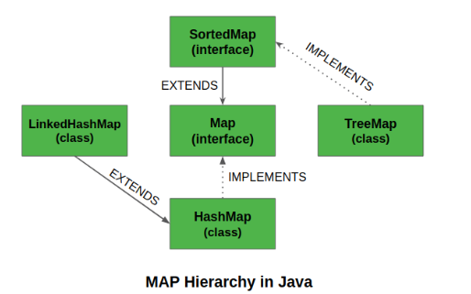
Map Interface in Java
The map interface is present in java.util package represents a mapping between a key and a value
Maps are perfect to use for key-value association mapping such as dictionaries

Slide 40
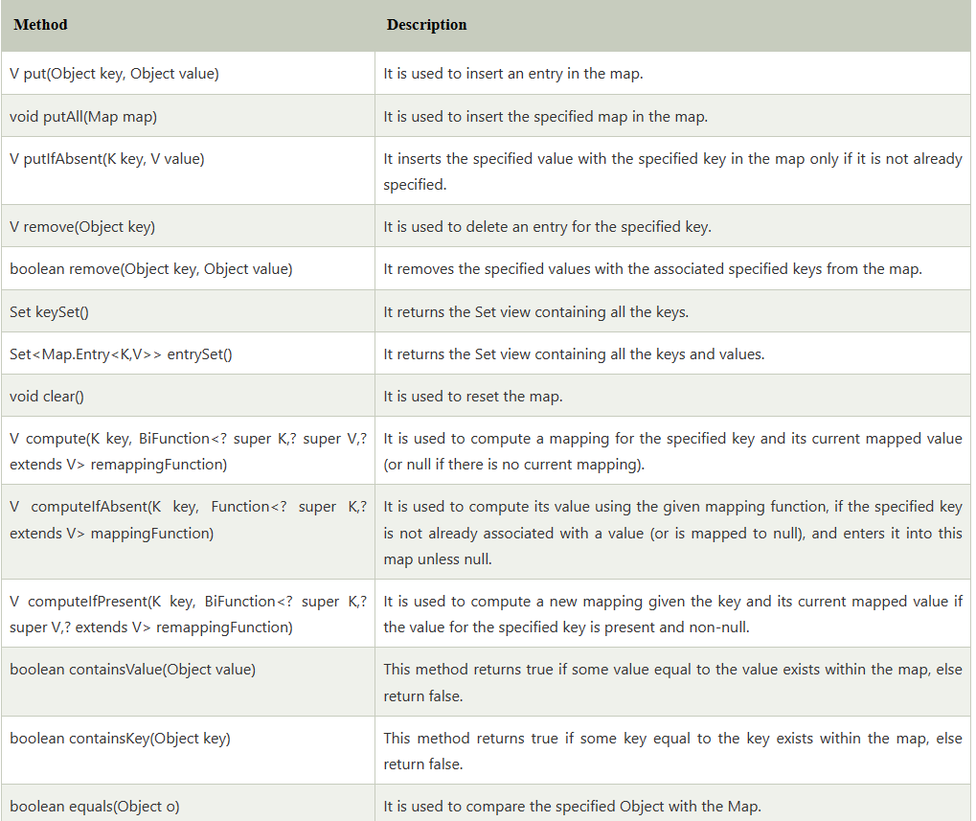

Slide 41
There are two interfaces for implementing Map in java. They are Map and SortedMap, and three classes: HashMap, TreeMap, and LinkedHashMap.
import java.util.*;
// Main class
class GFG {
// Main driver method
public static void main(String args[])
{
// Creating an empty HashMap
Map<String, Integer> hm
= new HashMap<String, Integer>();
// Inserting pairs in above Map
// using put() method
hm.put("a", new Integer(100));
hm.put("b", new Integer(200));
hm.put("c", new Integer(300));
hm.put("d", new Integer(400));
// Traversing through Map using for-each loop
for (Map.Entry<String, Integer> me :
hm.entrySet()) {
// Printing keys
System.out.print(me.getKey() + ":");
System.out.println(me.getValue());
}
}
}
a:100 b:200 c:300 d:400

Slide 42
import java.util.*;
class GFG {
public static void main(String args[])
{
// Initialization of a Map
// using Generics
Map<Integer, String> hm1
= new HashMap<Integer, String>();
// Inserting the Elements
hm1.put(new Integer(1), "Geeks");
hm1.put(new Integer(2), "Geeks");
hm1.put(new Integer(3), "Geeks");
System.out.println("Initial Map " + hm1);
hm1.put(new Integer(2), "For");
System.out.println("Updated Map " + hm1);
hm1.remove(new Integer(3));
}
}
Initial Map {1=Geeks, 2=Geeks, 3=Geeks} Updated Map {1=Geeks, 2=For, 3=Geeks}

Slide 43
Java program to Count Occurrence of number using Hashmap

Slide 44
import java.util.*;
class HelloWorld {
public static void main(String[] args) {
int a[]={1,13,4,1,41,31,31,4,13,2};
// put all elements in arraylist
ArrayList<Integer> aa=new ArrayList();
for(int i=0;i<a.length;i++){
aa.add(a[i]);
}
HashMap<Integer,Integer> h=new HashMap();
//counting occurrence of numbers
for(int i=0;i<aa.size();i++){
h.putIfAbsent(aa.get(i),Collections.frequency(aa,aa.get(i)));
}
System.out.println(h);
}
}
{1=2, 2=1, 4=2, 41=1, 13=2, 31=2}

Slide 45
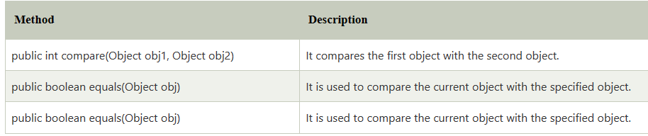
Java Comparator interface
is used to order the objects of a user-defined class.
contains 2 methods compare(Object obj1,Object obj2) and equals(Object element).

Slide 46
Collections class
Collections class provides static methods for sorting the elements of a collection
public void sort(List list, Comparator c): is used to sort the elements of List by the given Comparator.
Java program to sorting the elements of List on the basis of age and name

Slide 47
class Student{
int rollno;
String name;
int age;
Student(int rollno,String name,int age){
this.rollno=rollno;
this.name=name;
this.age=age;
}
}
import java.util.*;
import java.io.*;
class Simple{
public static void main(String args[]){
ArrayList al=new ArrayList();
al.add(new Student(101,"Vijay",23));
al.add(new Student(106,"Ajay",27));
al.add(new Student(105,"Jai",21));
System.out.println("Sorting by Name");
Collections.sort(al,new NameComparator());
Iterator itr=al.iterator();
while(itr.hasNext()){
Student st=(Student)itr.next();
System.out.println(st.rollno+" "+st.name+" "+st.age);}
import java.util.*;
class AgeComparator implements Comparator{
public int compare(Object o1,Object o2){
Student s1=(Student)o1;
Student s2=(Student)o2;
if(s1.age==s2.age)
return 0;
else if(s1.age>s2.age)
return 1;
else
return -1;
}
}
import java.util.*;
class NameComparator implements Comparator{
public int compare(Object o1,Object o2){
Student s1=(Student)o1;
Student s2=(Student)o2;
return s1.name.compareTo(s2.name); } }

Slide 48
System.out.println("Sorting by age");
Collections.sort(al,new AgeComparator());
Iterator itr2=al.iterator();
while(itr2.hasNext()){
Student st=(Student)itr2.next();
System.out.println(st.rollno+" "+st.name+" "+st.age);
}
}
}
Sorting by Name
106 Ajay 27
105 Jai 21
101 Vijay 23
Sorting by age
105 Jai 21
101 Vijay 23
106 Ajay 27

Slide 49
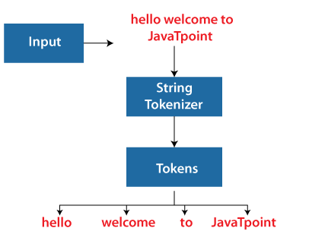
StringTokenizer in Java
The java.util.StringTokenizer class allows you to break a String into tokens.
It is simple way to break a String. It is a legacy class of Java.

Slide 50
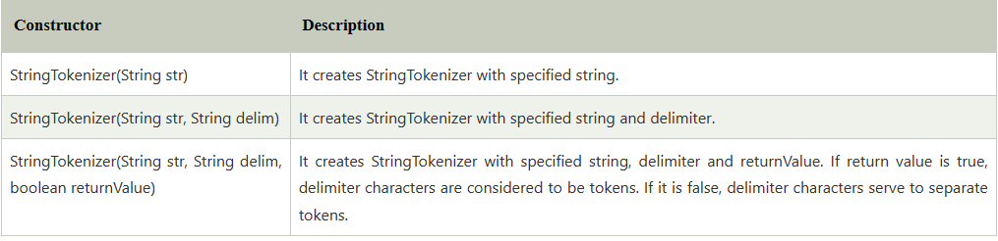
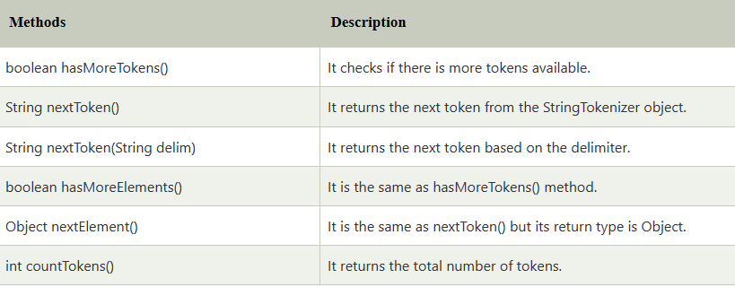

Slide 51
import java.util.StringTokenizer;
public class Simple{
public static void main(String args[]){
StringTokenizer st = new StringTokenizer("my name is khan"," ");
while (st.hasMoreTokens()) {
System.out.println(st.nextToken());
}
}
}

Slide 52
CLA - II

Slide 53
Answer any two questions:
Write a Java program to count number of words in a text file.
Write a java program to retrieve a particular record from an employee file based on Eno. (Assume Employee file consists of record fields like Eno, Ename, salary, Dept)
(a)Explain about JAVA Generics with an example.
(b)Explain about Java Autoboxing and unboxing with an example.
4. Write a java program that reads the data from two files and writes into another file

Slide 54
Project report contents:
Title
Aim and Objectives
Introduction
System requirements
Modules with main functions explonation
Code with results (screen shorts)
Conclusions

Slide 55
Database
A database is an organized collection of structured information, or data, typically stored electronically in a computer system.
A database is usually controlled by a database management system (DBMS).
Together, the data and the DBMS, along with the applications that are associated with them, are referred to as a database system, often shortened to just database.
Data within the most common types of databases in operation today is typically modeled in rows and columns in a series of tables to make processing and data querying efficient.
The data can then be easily accessed, managed, modified, updated, controlled, and organized. Most databases use structured query language (SQL) for writing and querying data.

Slide 56
Database Models
Hierarchical model
Network model
Entity - Relationship (E-R)model
Relational model
Object oriented data model

Slide 57
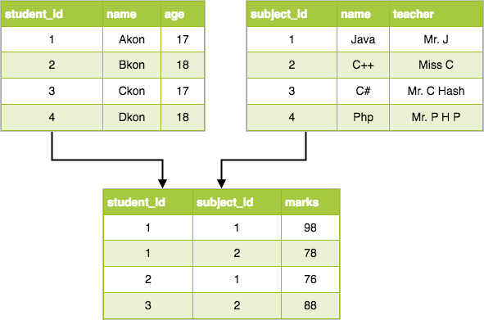
Relational Model
Data is organized in two-dimensional tables and the relationship is maintained by storing a common field.
The basic structure of data in the relational model is tables.
All the information related to a particular type is stored in rows of that table.
Hence, tables are also known as relations in relational model.
Figure:
Relational model

Slide 58
Database software
Database software is used to create, edit, and maintain database files and records, enabling easier file and record creation, data entry, data editing, updating, and reporting. The software also handles data storage, backup and reporting, multi-access control, and security. Strong database security is especially important today, as data theft becomes more frequent.
Database software is sometimes also referred to as a “database management system” (DBMS).

Slide 59
SQL Commands
SQL stands for Structured Query Language.
SQL is used to create, remove, alter the database and database objects in a database management system and to store, retrieve, update the data in a database.
SQL works for all modern relational database management systems, like SQL Server, Oracle, MySQL, etc.
Different types of SQL commands
DDL : Data Definition Language
DML: Data Manipulation Language
DQL : Data Query Language
DCL: Data Control Language
TCL : Transaction Control Language

Slide 60
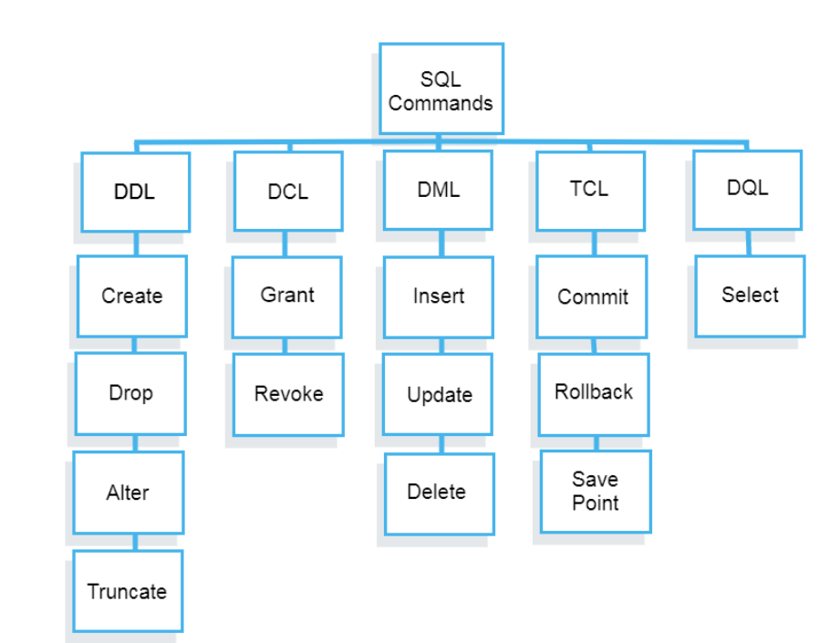

Slide 61
DDL commands
1. CREATE
CREATE command is used to create a database and database object like a table, index, view, trigger, stored procedure, etc.
Syntax: CREATE DATABASE DatabaseName;
Use databasename; CREATE TABLE TableName (Column1 Datatype1, Column2 Datatype2,…,ColumnNDatatypeN);
CREATE TABLE Employee (Id INT, Name VARHCAR(50), Address VARCHAR (100));
2. ALTER
ALTER command is used to restructure the database object and the settings in the database.
Syntax
ALTER TABLE TableName ADD ColumnNameData_Type; ALTER TABLE TableName DROPColumnName; ALTER TABLE TableName MODIFY COLUMNColumnNameData_Type;
ALTER TABLE Employee ADD Salary INT;
3. TRUNCATE
The TRUNCATE command is used to remove all the data from the table. TRUNCATE command empties a table. (is used to remove all the rows from the table.)
Syntax TRUNCATE TABLE TableName;
TRUNCATE TABLE Employee;
4. DROP
DROP command is used to remove the database and database object. (entire table structure)
Syntax DROP TABLE TableName;
DROP TABLE Employee;

Slide 62
DML commands
1 INSERT INTO
INSERT INTO command is used to add data to the database table.
Syntax Insert into <table_name>values(<value1>,<value2>,<value3>…….,<valuen>);
INSERT INTO Employee (Id, Name, Address, Salary) VALUES (1, ‘Arvind Singh’, ‘Pune’, 1000);
2. UPDATE UPDATE <table_name> SET column_number =value_number WHERE condition;
UPDATE command is used to update data in the database table. A condition can be added using the WHERE clause to update a specific row.
Syntax
UPDATE Employee SET Address = ‘Pune India’, Salary = 100 WHERE Id =1;
3. DELETE Delete from <table_name>WHERE condition;
DELETE command is used to remove data from the database table. A condition can be added using the WHERE clause to remove a specific row which meets the condition.
Syntax
DELETE FROM Employee WHERE Id =1;

Slide 63
DQL commnads
DQL stands for the data query language. DQL command is used for fetching the data. DQL command is used for selecting data from the table, view, temp table, table variable, etc. There is only one command under DQL which is the SELECT command.
Syntax SLECT From Table name [Where condition]
SELECT * FROM Employee;

Slide 64
DCL commnads
DCL stands for data control language. DCL commands are used for providing and taking back the access rights on the database and database objects. DCL command used for controlling user’s access on the data. Most used DCL commands are GRANT and REVOKE.
1. GRANT
GRANT is used to provide access right to the user.
Syntax GRANT SELECT, UPDATE ON MY_TABLE TO SOME_USER, ANOTHER_USER;
GRANT INSERT, DELETE ON Employee TO user;
2. REVOKE REVOKE privilege_nameON object_nameFROM {user_name |PUBLIC |role_name}
REVOKE command is used to take back access right from the user, it cancels access right of the user from the database object.
Syntax
REVOKE ALL ON Employee FROM user;

Slide 65
TCL commands
TCL stands for transaction control language. TCL commands are used for handling transactions in the database. Transactions ensure data integrity in the multi-user environment. TCL commands can rollback and commit data modification in the database. The most used TCL commands are COMMIT, ROLLBACK, SAVEPOINT, and SET TRANSACTION.
1. COMMIT
COMMIT command is used to save or apply the modification in the database.
2. ROLLBACK
ROLLBACK command is used to undo the modification.
3. SAVEPOINT
SAVEPOINT command is used to temporarily save a transaction, the transaction can roll back to this point when it's needed.
Syntax
J ust write COMMIT or ROLLBACK or SAVEPOINT;

Slide 66
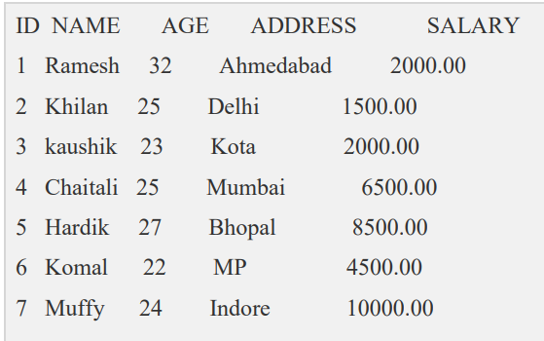
Employee database:
List all the records in the employee relation
List the name, and address of the employee in the employee relation
List the age above 25 records in the employee table
List the employees with age < 25 and the salary above 2000
List the employees with the names starting with “K” letter
List the employees names and ID with salary between 3000 and 6000
List the employees according to their names

Slide 67
List all the records in the employee relation
List the name, and address of the employee in the employee relation
List the age above 25 records in the student table
List the employees with age < 25 and the salary above 2000
List the employees with the names starting with “K” letter
List the employees names and ID with salary between 3000 and 6000
List the employees according to their names
select * from employee where name like ‘K%'
select id, name from employee where salary between 3000 and 6000
select * from employee order by name

Slide 68
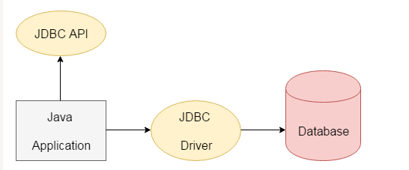
Java JDBC Tutorial
JDBC stands for Java Database Connectivity. JDBC is a Java API to connect and execute the query with the database. It is a part of JavaSE (Java Standard Edition). JDBC API uses JDBC drivers to connect with the database. There are four types of JDBC drivers:
We can use JDBC API to access tabular data stored in any relational database. By the help of JDBC API, we can save, update, delete and fetch data from the database. It is like Open Database Connectivity (ODBC) provided by Microsoft.

Slide 69
The current version of JDBC is 4.3.
It is based on the X/Open SQL Call Level Interface.
The java.sql package contains classes and interfaces for JDBC API.
A list of popular interfaces of JDBC API are given below:
Driver interface
Connection interface
Statement interface
PreparedStatement interface
CallableStatement interface
ResultSet interface
ResultSetMetaData interface
DatabaseMetaData interface
RowSet interface
A list of popular classes of JDBC API are given below:
DriverManager class
Blob class
Clob class
Types class

Slide 70
Before JDBC, ODBC API was the database API to connect and execute the query with the database.
But, ODBC API uses ODBC driver which is written in C language (i.e. platform dependent and unsecured).
Therefore, Java has defined its own API (JDBC API) that uses JDBC drivers (written in Java language).
We can use JDBC API to handle database using Java program and can perform the following activities:
Connect to the database
Execute queries and update statements to the database
Retrieve the result received from the database.

Slide 71
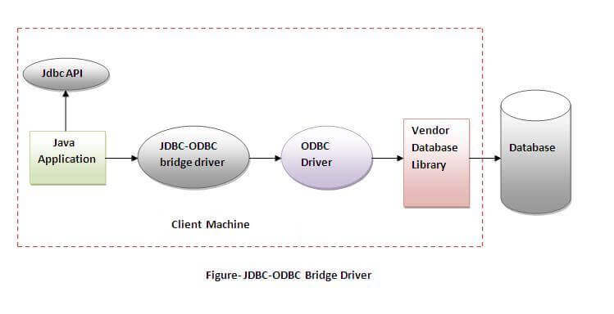
JDBC Driver
JDBC Driver is a software component that enables java application to interact with the database. There are 4 types of JDBC drivers: JDBC-ODBC Bridge Driver, Native Driver, Network Protocol Driver, and Thin Driver The JDBC-ODBC bridge driver uses ODBC driver to connect to the database. The JDBC-ODBC bridge driver converts JDBC method calls into the ODBC function calls. This is now discouraged because of thin driver.
The JDBC-ODBC bridge driver uses ODBC driver to connect to the database. The JDBC-ODBC bridge driver converts JDBC method calls into the ODBC function calls. This is now discouraged because of thin driver.

Slide 72
Oracle does not support the JDBC-ODBC Bridge from Java 8. Oracle recommends that you use JDBC drivers provided by the vendor of your database instead of the JDBC-ODBC Bridge.
Advantages:
easy to use.
can be easily connected to any database.
Disadvantages:
Performance degraded because JDBC method call is converted into the ODBC function calls.
The ODBC driver needs to be installed on the client machine.

Slide 73
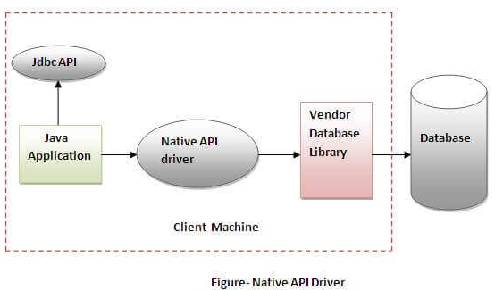
Native-API driver
The Native API driver uses the client-side libraries of the database. The driver converts JDBC method calls into native calls of the database API. It is not written entirely in java.
Advantage:
performance upgraded than JDBC-ODBC bridge driver.
Disadvantage:
The Native driver needs to be installed on the each client machine.
The Vendor client library needs to be installed on client machine.

